Slide 1

SkillSwap – Exchange Skills, Not Money
Presented by the proton edge, a project designed to revolutionise skill-building and community collaboration.
Team Members:
Madhura Lakade
Shreyash Gore
Anish Mogam

Slide 2

The Challenge: Barriers to Skill Development
High Costs
Quality skill-building resources are often prohibitively expensive, creating significant barriers, especially for students and those in lower-income communities.
Limited Sharing
Many talented individuals struggle to find meaningful platforms to share their expertise and contribute to a larger learning ecosystem.
No Structured Exchange
Existing communities lack organised systems for skill-for-skill exchanges, hindering organic learning and mutual growth.
Monetary Focus
Current platforms are predominantly transaction-based, prioritising financial exchange over collaborative learning and community building.

Slide 3


SkillSwap: Our Innovative Solution
SkillSwap is a cutting-edge peer-to-peer skill exchange platform designed to foster a zero-cost, community-driven learning network.
User-Driven Offers & Needs
Users can effortlessly post skills they possess and skills they wish to acquire, creating a dynamic marketplace of knowledge.
AI-Powered Matching
Our intelligent AI engine suggests the most compatible matches, connecting individuals based on their learning objectives and teaching capabilities.
Seamless Coordination
Integrated in-app chat facilitates direct communication and scheduling, ensuring smooth and efficient skill exchanges.

Slide 4







Robust Technology Stack
Our platform is built on a modern, scalable, and secure technology stack, ensuring a seamless user experience.
Frontend
Backend
Database
React Native / Flutter for cross-platform compatibility and fluid interfaces.
Node.js with Express.js for efficient and scalable server-side operations.
MongoDB / PostgreSQL for flexible and robust data storage solutions.
AI Engine
Authentication
Real-time Chat
Python with Scikit-Learn / TensorFlow for intelligent matchmaking algorithms.
Firebase/OAuth for secure and streamlined user authentication.
Socket.io for instant messaging and seamless communication.
Deployment
AWS / Vercel for reliable and scalable cloud infrastructure.

Slide 5
Core Features & Unique Value Proposition
Core Features
What Makes Us Unique?
Dynamic Posts
Users create detailed posts for skills they can offer and skills they require.
Zero-Cost Exchange
Smart Matchmaking
No financial transactions, fostering pure skill bartering and mutual
benefit.
AI-driven system for highly accurate skill-to-skill pairing.
AI-Enhanced Efficiency
Credibility & Trust
Intelligent matchmaking drastically improves success rates and user
satisfaction.
User ratings, reviews, and verified skill badges build a trusted community.
Integrated Communication
Community Focus
Real-time chat and scheduling tools for seamless interaction.
Cultivates vibrant, hyperlocal learning networks and strengthens community bonds.
Diverse Categories
Extensive filters covering tech, arts, fitness, academics, and more.
Peer Empowerment
Actively encourages mentorship, collaboration, and shared
knowledge growth.

Slide 6

Our Business Model Canvas
SkillSwap's sustainable model focuses on community value and strategic growth.
Revenue Streams
Customer Segments
Value Proposition
Key Activities
Key Resources
Our canvas highlights how SkillSwap creates, delivers, and captures value through its innovative approach to skill exchange.

Slide 7





Scalability & Real-World Impact
Instant Scalability
Local & Global Fit
Our AI matching system is designed to scale effortlessly with user growth, ensuring optimal performance regardless of platform size.
Ideal for universities, local communities, and global networks, SkillSwap facilitates learning with minimal operational costs.
Democratised Learning
High Feasibility
Promotes accessible learning for everyone, fostering skill upliftment and bridging knowledge gaps worldwide.
Leveraging existing, proven technologies ensures a high implementation feasibility and rapid deployment.

Slide 8
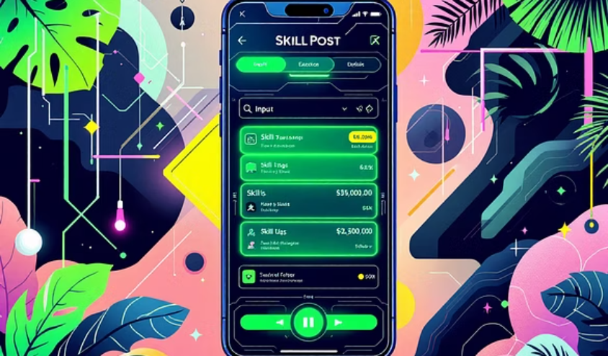
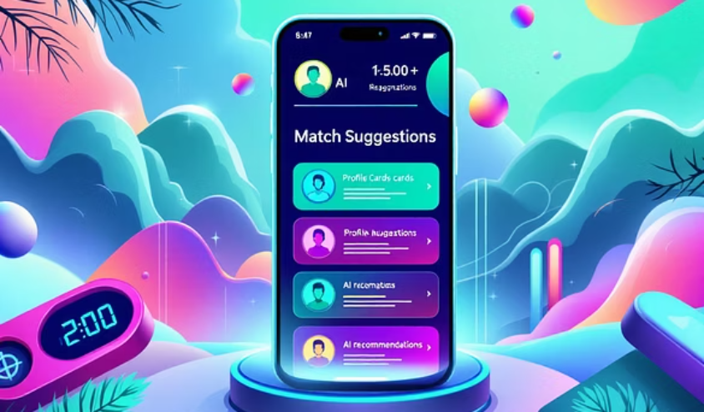
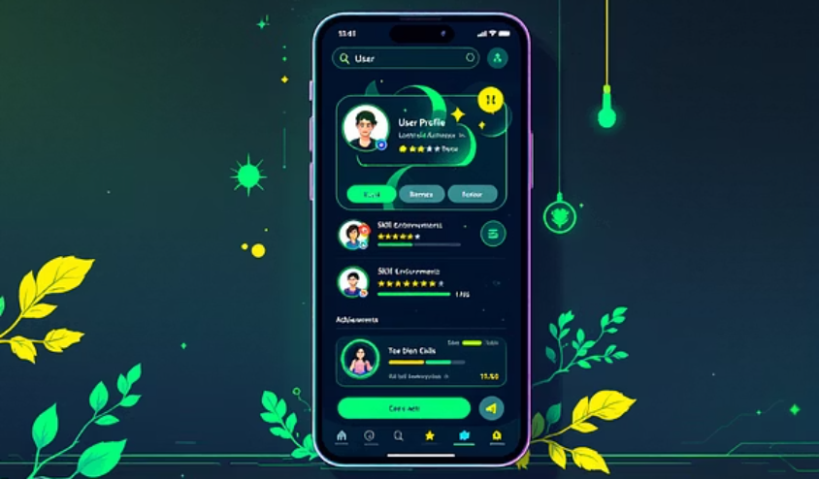
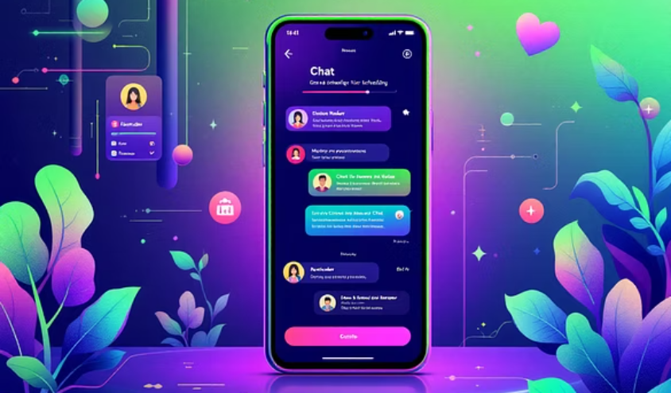
Prototype Overview & Conclusion
Our prototype showcases the intuitive design and core functionalities of SkillSwap, providing a glimpse into the future of collaborative learning.
Conclusion: Building a Smarter, More Skillful World
SkillSwap makes skill-building accessible, collaborative, and entirely cost-free. It's a scalable, AI-powered platform poised to create a smarter and more skillful
Worl d for all.
Thank you for your time and consideration! 🚀🔥

